Slide 1

Where to install a funerary parlour commercial office in Barcelona

Slide 2
Business problem
Client: funerary parlour operator in Barcelona
Business question: where to install a funerary parlour commercial office in Barcelona
Data: (i) population, (ii) population over 65 years of age, (iii) number of interesting nearby venues
Neighborhoods that have high (i), (ii) and (iii) will be suitable to respond to the business question

Slide 3
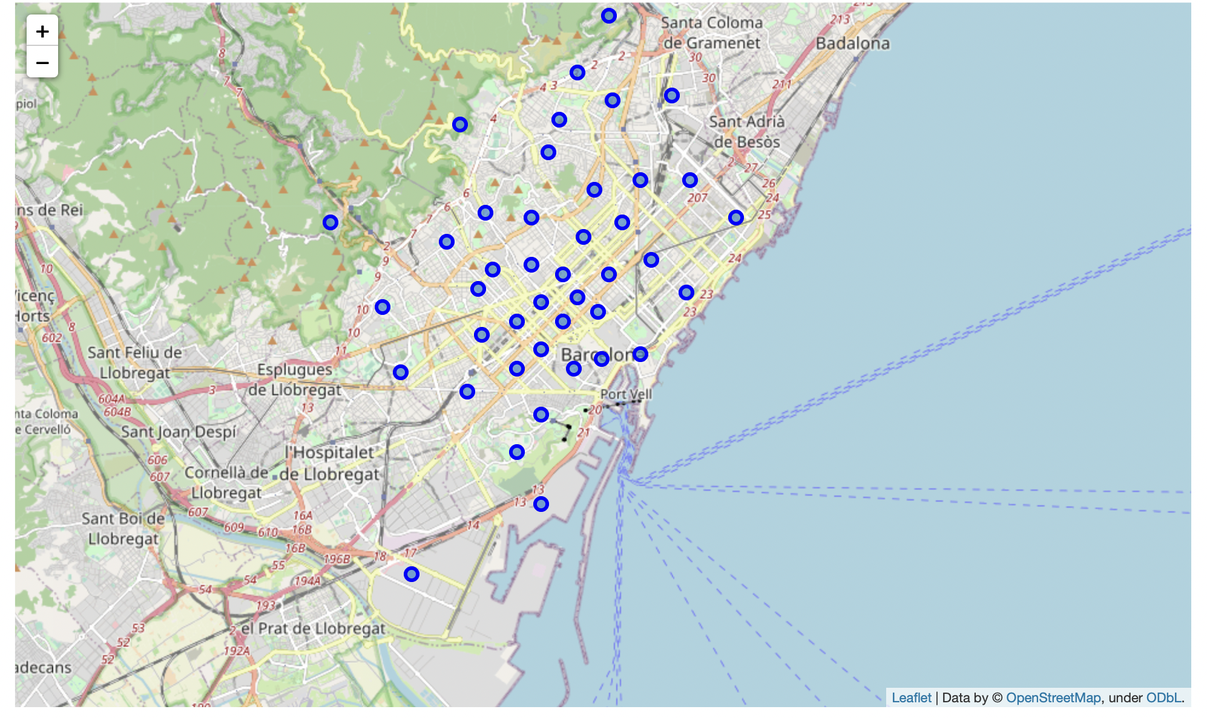
Current Location of Barcelona neighborhoods indicates similar spread across city

Slide 4
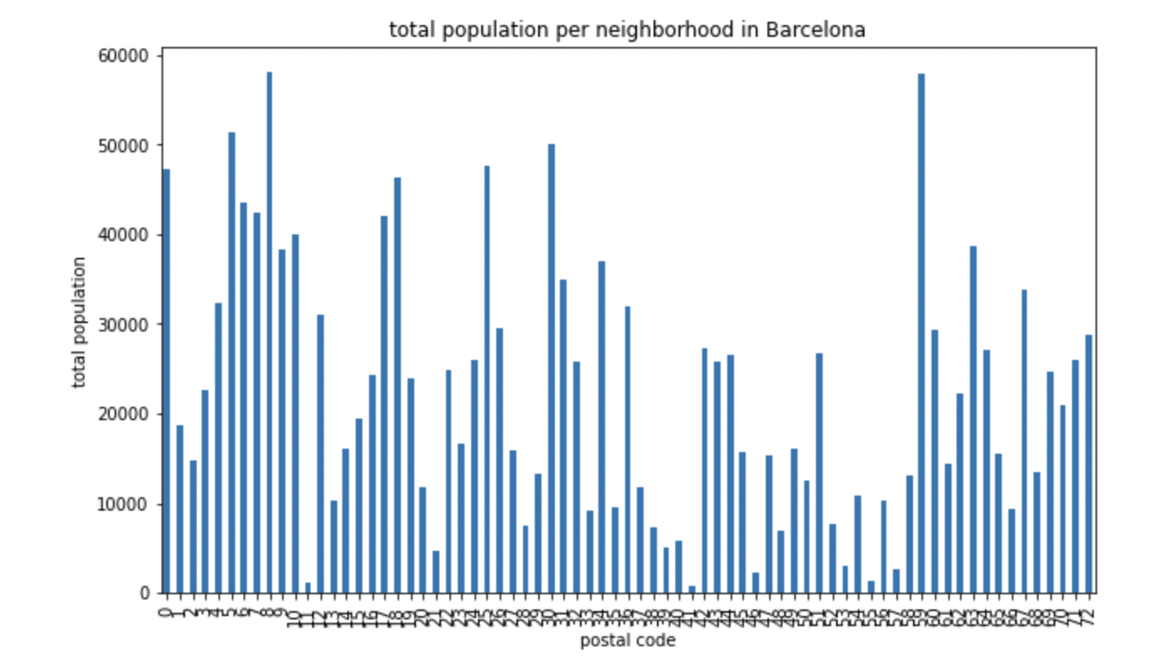
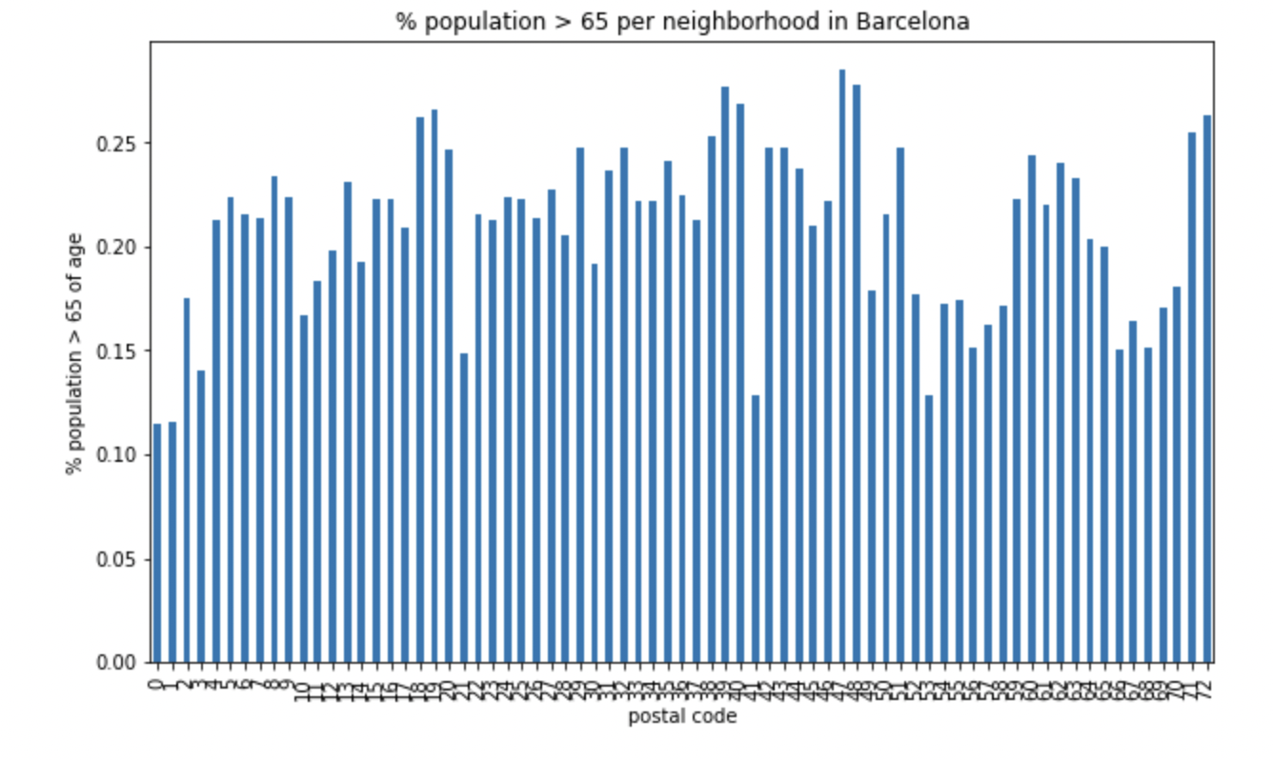
Exploratory data analysis indicates high spread in both population and population > 65 years of age

Slide 5
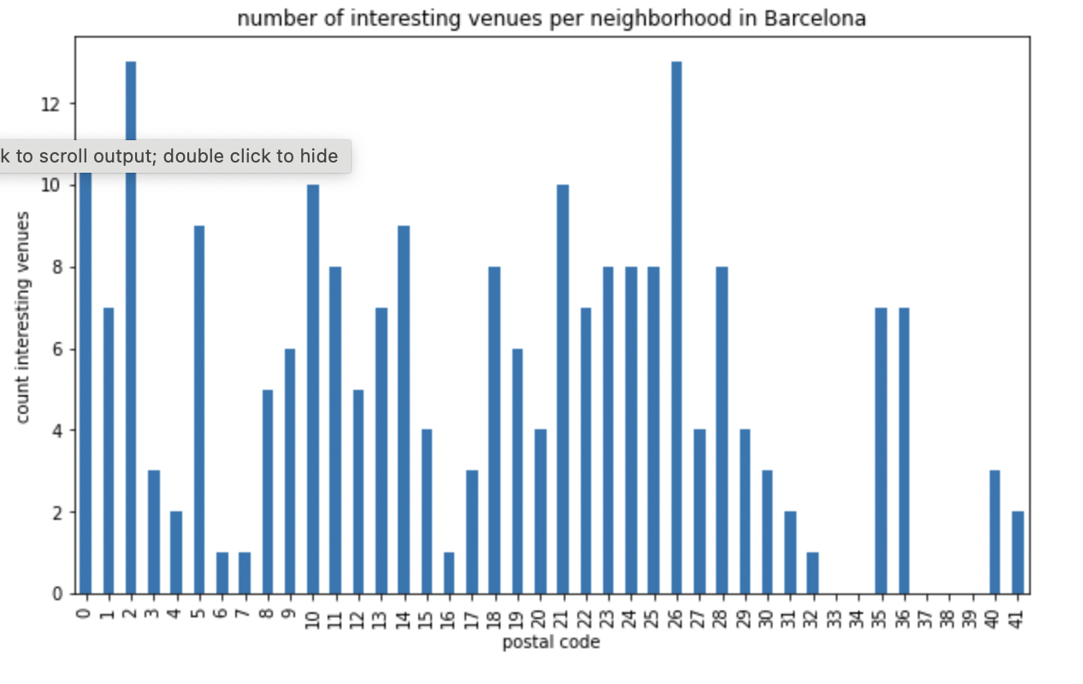
Also, high spread of number of interesting venues per neighborhood

Slide 6
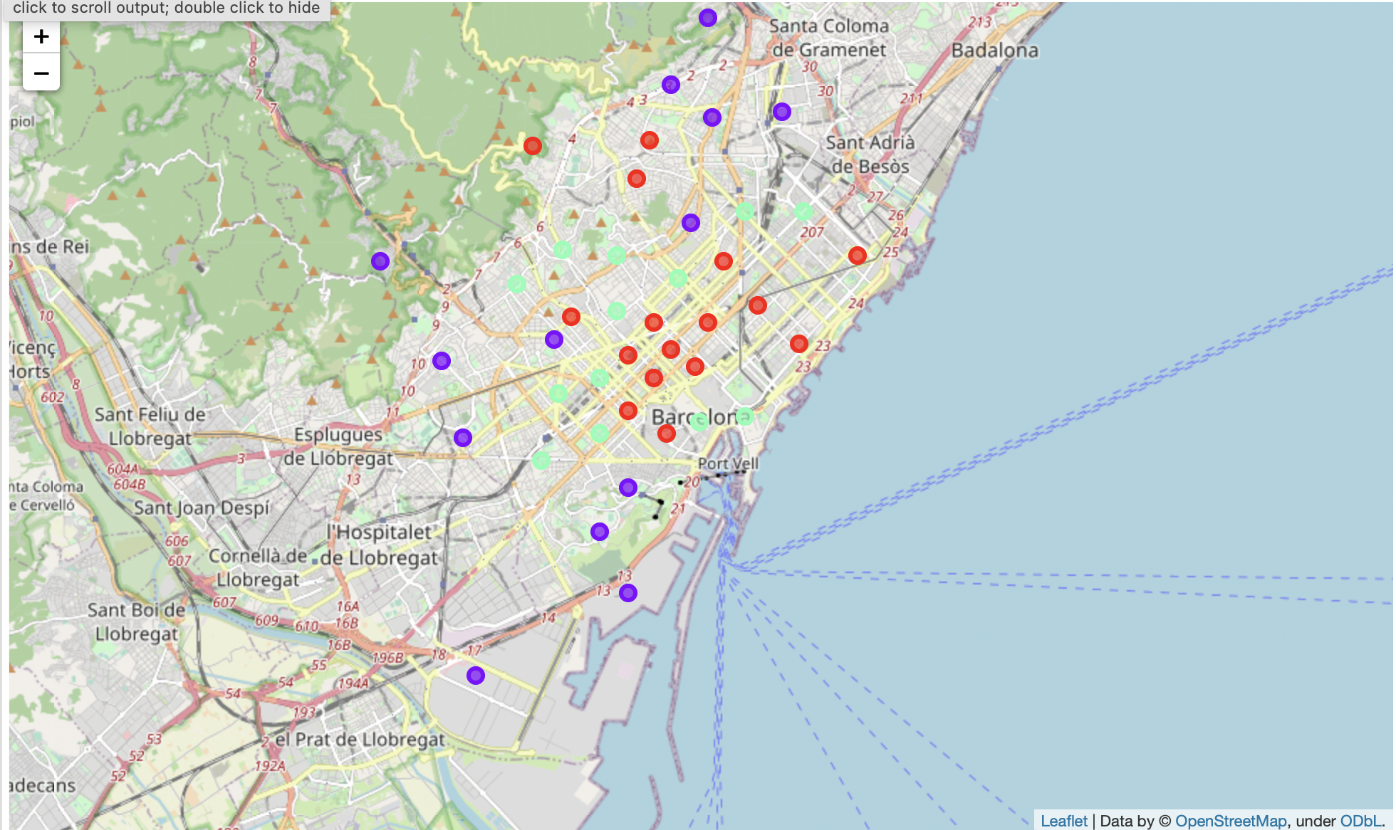
Resulting Clustering of Barcelona neighborhoods using K-Means classification
3 Clusters
Cluster 2 = high population, high population over 65 years of age and high number of interesting venues (green colour)

Slide 7
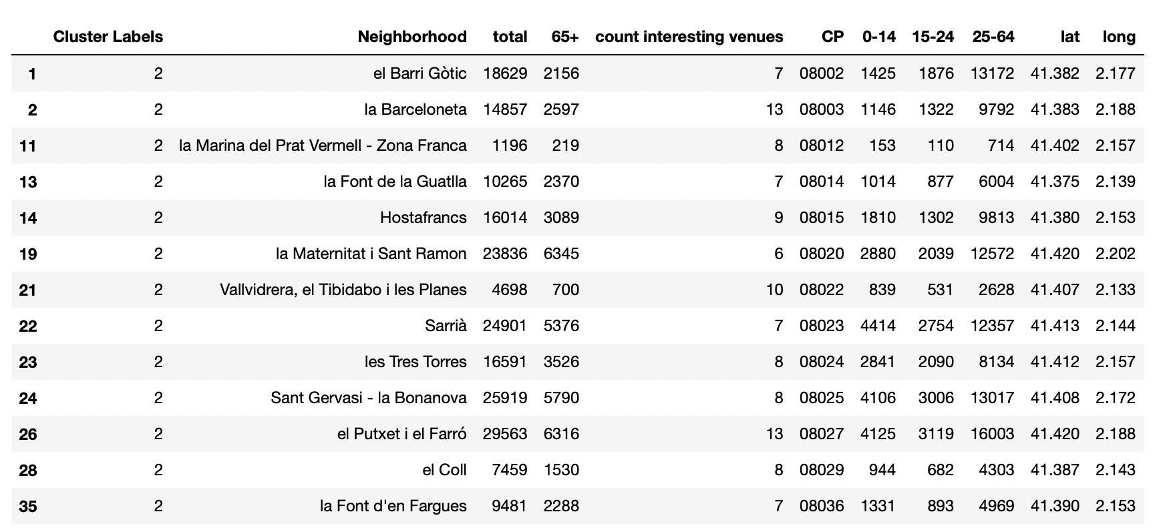
Conclusion
Recommendation to install a funerary parlour commercial office in either of the following neighborhoods: 08020, 08025 or 08027

